Slide 1

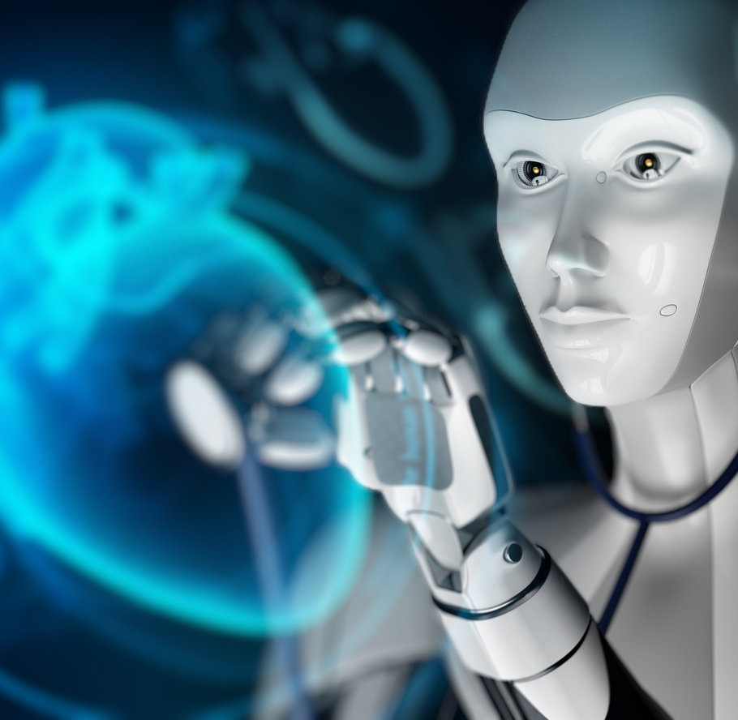
REVOLUTIOIZING MEDICAL DIAGNOSIS: A DEEP LEARNING APPROACH TO IMAGE CLASSIFICATIONG
FINAL PROJECT
Rachana Kurra

Slide 2

CONTENTS
01.
INTRODUCTION
02.
DEVELOPMENTS OF DEEP LEARNING MODELS
03.
TECHNIQUES IN DEEP LEARNING
04.
HEALTH CARE INDUSTRY
05.
CASE STUDY
06.
LIMITATIONS
07.
CONCLUSION

Slide 3

INTRODUCTION
Deep Learning is a subset of machine learning that focuses on the development of artificial neural networks that can learn and make decisions on their own. It is inspired by the structure and function of the human brain and is capable of learning from large amounts of data to improve its accuracy over time.
DL models are capable of processing large amounts of structured and unstructured data, such as medical images, electronic health records, and genomics data, to identify patterns and make accurate predictions.

Slide 4
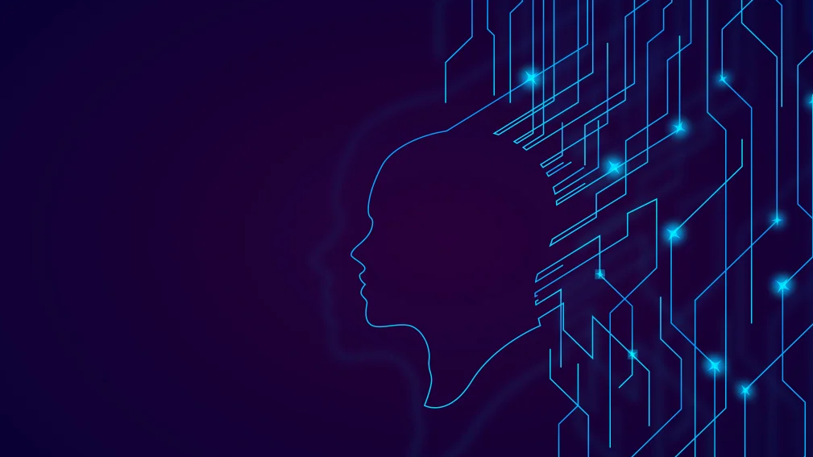
IMPORTANCE
DEEP LEARNING CAN GO REALLY ADVANCED IN TERMS OF ITS ABILITY TO AUTOMIZE THE PROCESS. SOME OF THE SALIENT FEATURES ARE :
IMPROVED ACCURACY
SCALABILITY
FLEXIBILITY
AUTOMATION
REAL WORLD APPLICATIONS

Slide 5
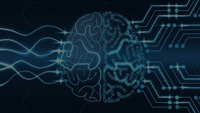
DEVELOPMENT
THE CAPACITY OF DL IS VERY VAST AND IT HAS ALREADY BEEN SPREAD TO VARIOUS SECTORS . SOME MAJOR DEVELOPMENTS TOOK PLACE IN:
COMPUTER VISION
AEROSPACE & MILITARY
HEALTH CARE: MEDICAL RESEARCH
TRANSPORT INDUSTRY
GENERATING TEXT
SECURITY

Slide 6
TECHINQUES
DEEP LEARNING TECHNIQUES HAVE REVOLUTIONIZED VARIOUS FIELDS BY ENABLING COMPUTERS TO LEARN COMPLEX PATTERNS AND MAKE ACCURATE PREDICTIONS.
CNN - CONVOLUTION NEURAL NETWORKS
RNN – RECURRENT NEURAL NETWORKS
GAN – GENERATIVE ADVERSARIAL NETWORKS
ADVANTAGES

Slide 7
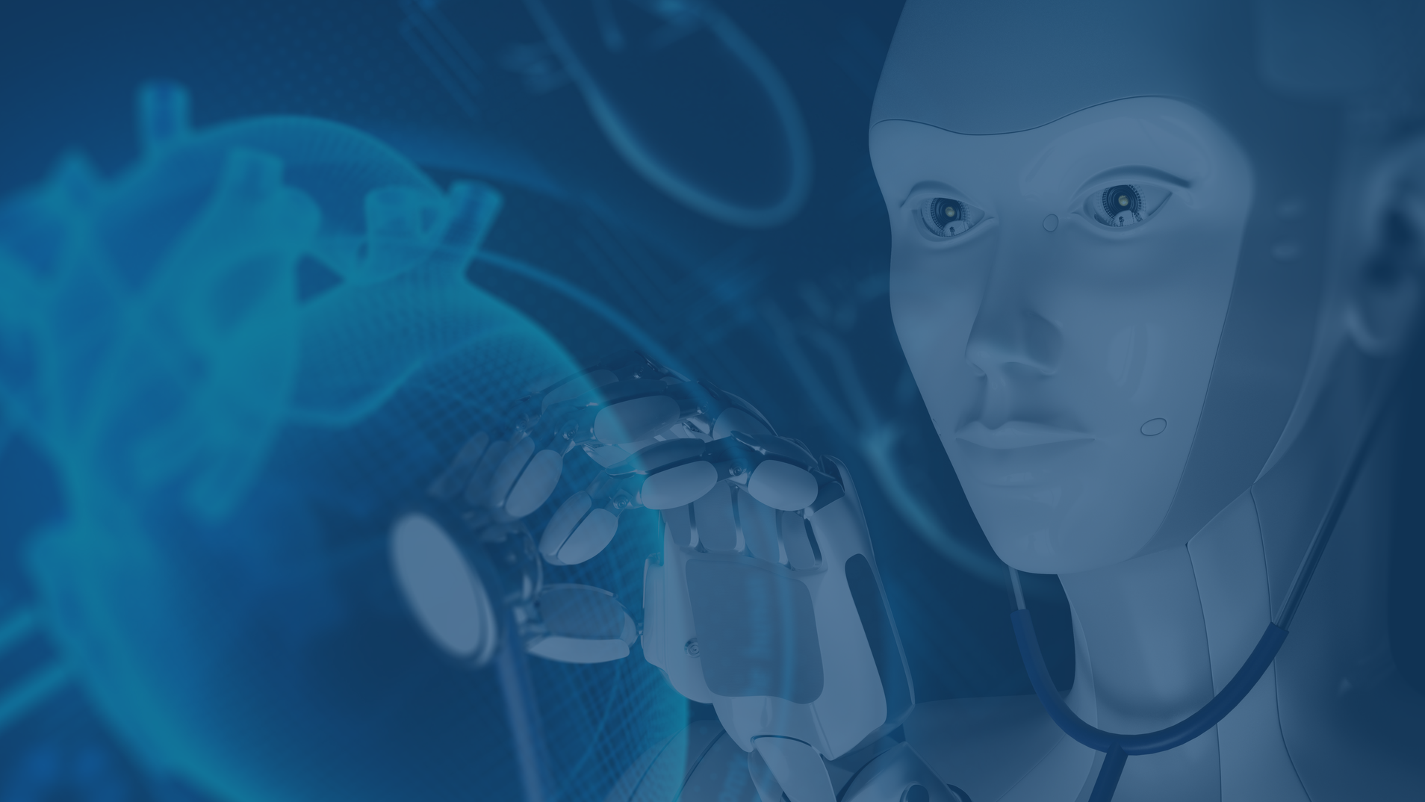
HEALTHCARE INDUSTRY AND CASE STUDY

Slide 8
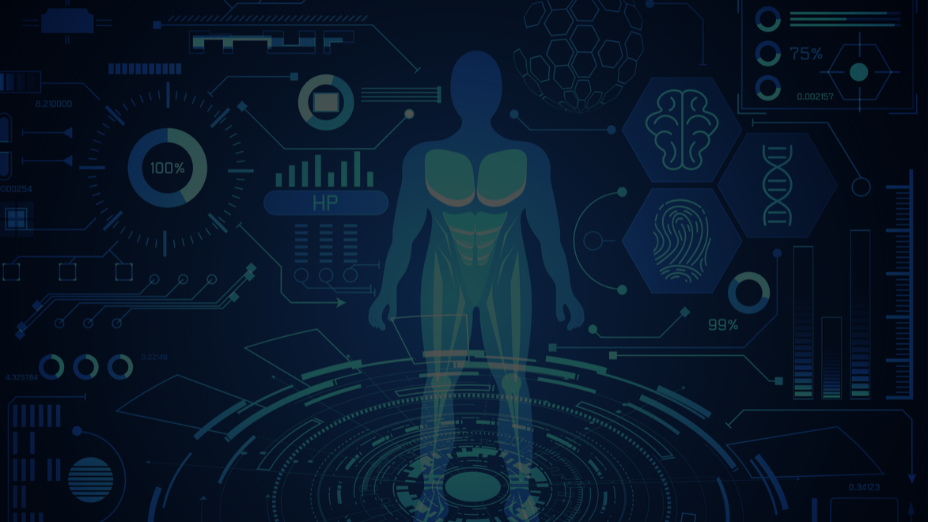
Medical Image Classification
MEDICAL IMAGING PLAYS A MAJOR ROLE IN DIAGNOSIS.
TO UNDERSTAND THE IMAGES WE NEED HIGH SKILLED PROFESSIONALS WHO MAY NOT BE READILY AVAILABLE.
CNN EMERGES AS A POWERFUL TOOL FOR THIS.
ABILITY TO LEARN AUTOMATICALLY AND EXTRACT FEATURES FROM MEDICAL IMAGES.
NORMALITY OR ABNORMALITY TRAINED BY LARGE AMOUNT OF MEDICAL DATA
VERY FAST AND HIGHLY ACCURATE
CAN BE TRAINED TO IDENTIFY SPECIFIC PATTERNS.

Slide 9
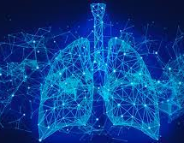
CASE STUDY
A case study used a CNN algorithm to classify chest X-ray images as either normal or showing signs of pneumonia. The algorithm was trained on a large dataset of X-ray images, with the goal of accurately detecting pneumonia to aid in diagnosis and treatment considering all aspects.
The CNN algorithm works by analyzing the image at different levels in detail, allowing it to detect precise patterns and features that may indicate the presence of pneumonia. After being trained on the dataset, the algorithm was able to accurately classify X-ray images with a high degree of accuracy.

Slide 10


Limited transferability
Hardware Limitations
Ethical Considerations
Interpretability
Limited transferability

Slide 11

MEDICAL IMAGE CLASSIFICATION USING DEEP LEARNING TECHNIQUES, ESPECIALLY CNNS, HAS SHOWN SIGNIFICANT POTENTIAL TO IMPROVE DISEASE DIAGNOSIS ACCURACY AND EFFICIENCY. THEY REDUCE TIME AND EFFORT BY AUTOMATION OF THE DIAGNOSIS AND THIS LEADS TO FASTER TREATMENT AND OUTCOMES. DEEP LEARNING MODELS CAN IDENTIFY PATTERNS AND STRUCTURES THAT ARE NOT MANUALLY SEEN, ENABLING EARLIER DETECTION OF DISEASES. HOWEVER, THERE ARE STILL CHALLENGES TO BE ADDRESSED, SUCH AS THE CLASS IMBALANCE PROBLEM AND THE INTERPRETABILITY OF CNNS. OVERALL, THE USE OF DEEP LEARNING IN MEDICAL IMAGE CLASSIFICATION SHOWS GREAT PROMISE FOR ADVANCING THE FIELD OF MEDICAL IMAGING WITH SOME LIMITATIONS.

Slide 12
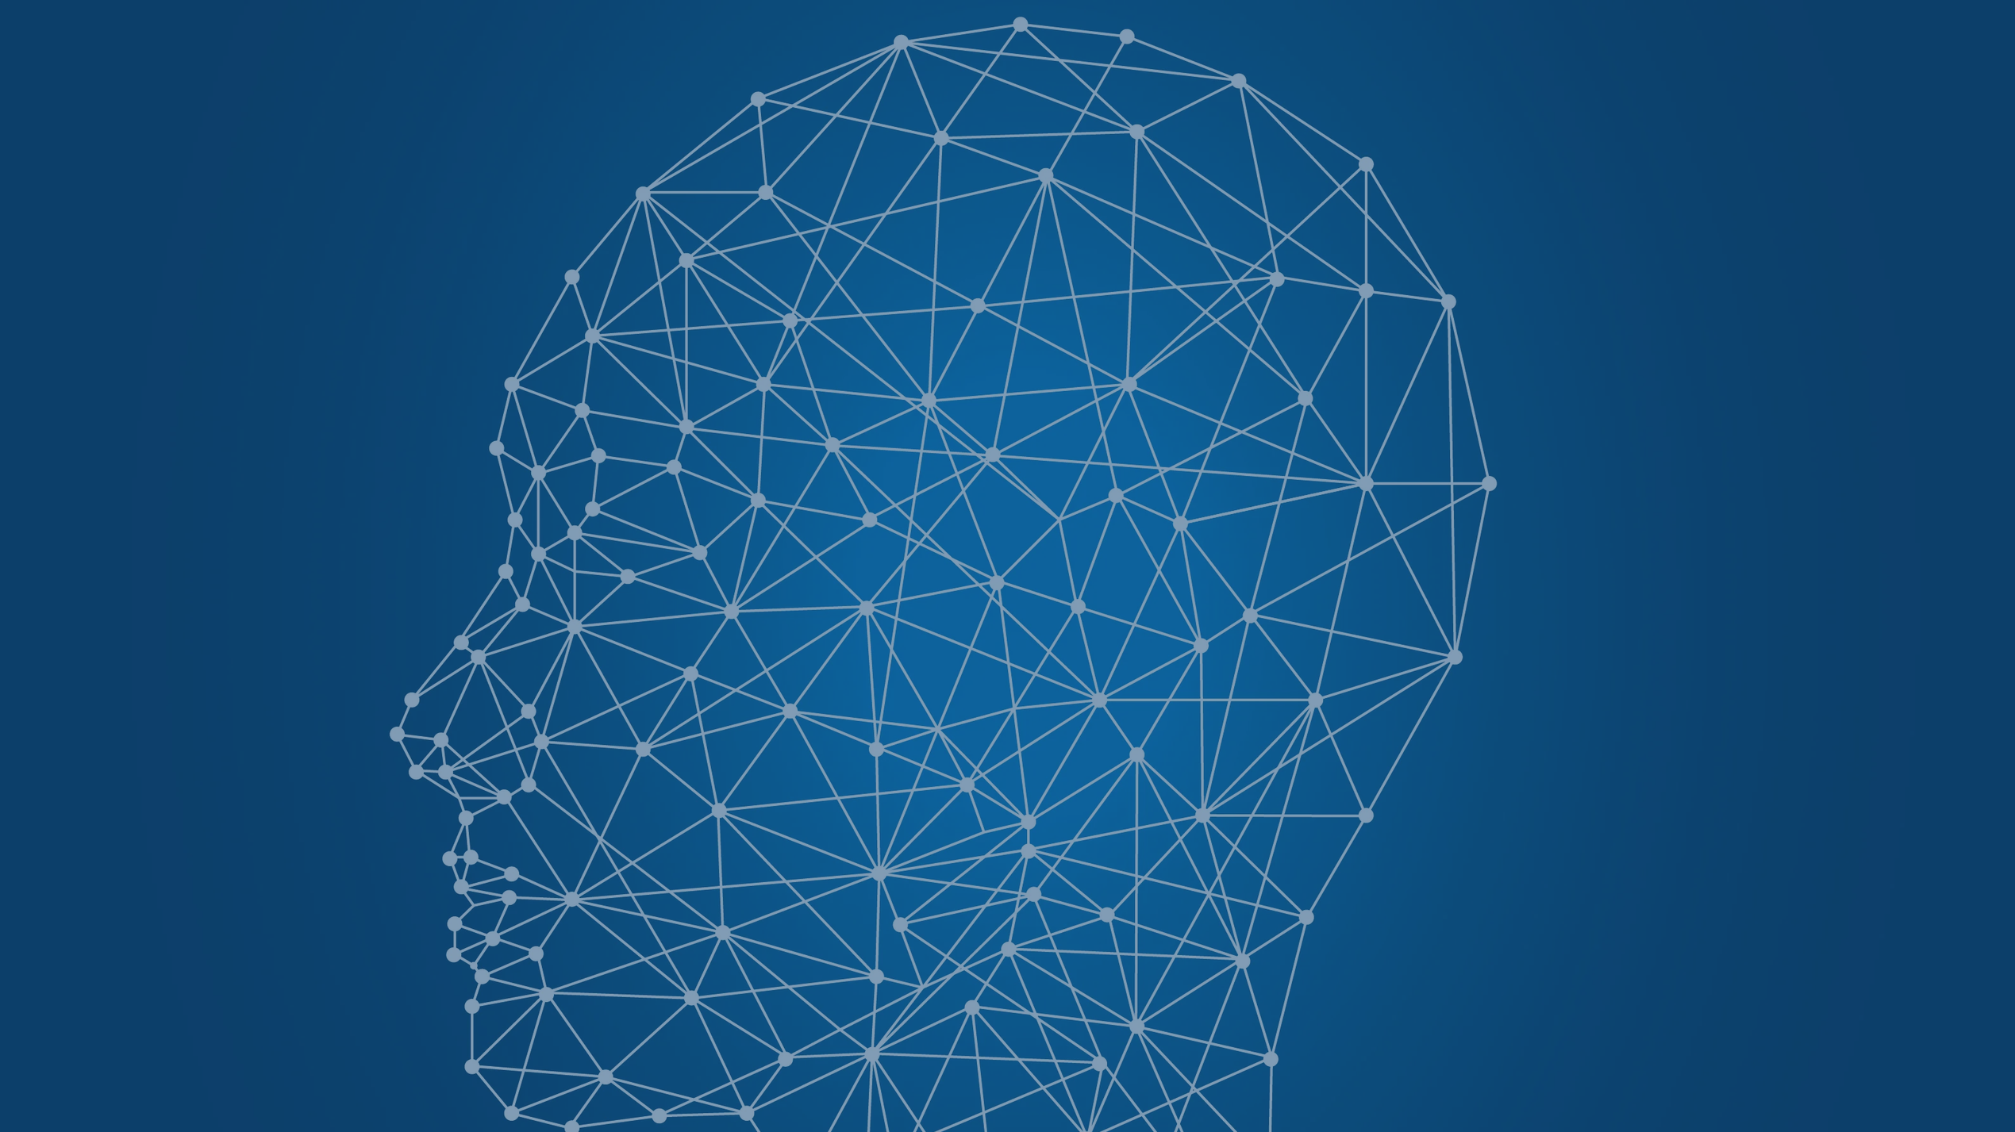
THANK YOU

